Slide 1
Python Dash
January, 2023

Slide 2
Outline
1 Pandas Overview
2 Pandas and Plotly
3 Dash
4 Dash Callbacks
Appendix

Slide 3
Pandas Overview

Slide 4

What is Pandas
Overall, Pandas is an open-source, easy to use data analysis and manipulation tool built on top of Python.

Slide 5
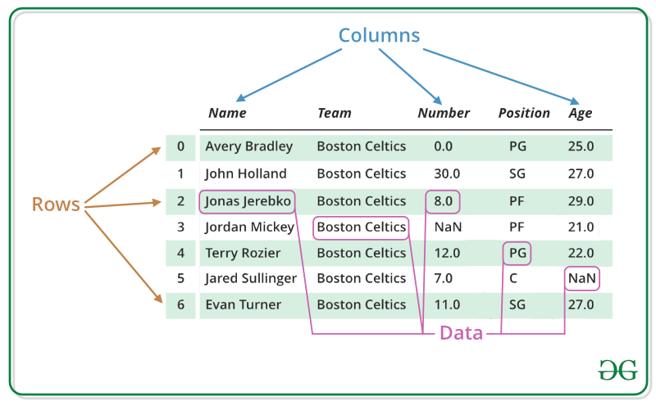
How does Pandas work?
Pandas allows us to read information through a DataFrame, which is highly similar to an Excel sheet.
Note:
Source:

Slide 6
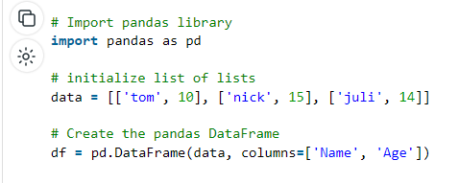
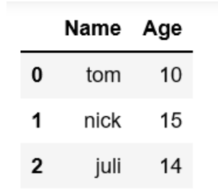
Creating a Dataframe
Note:
Source:

Slide 7
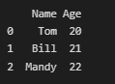
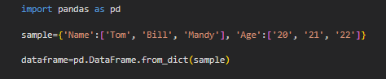
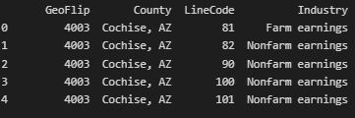
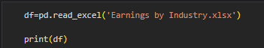
Creating a Dataframe
Note:
Source:

Slide 8
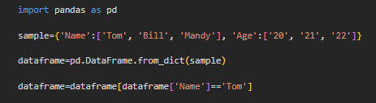
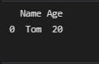
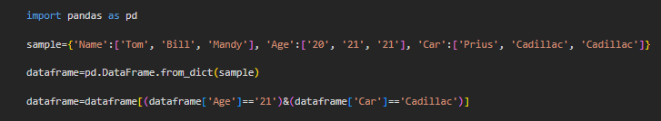
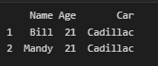
Filtering a Dataframe
Note:
Source:

Slide 9
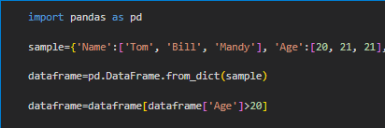
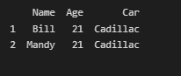
Filtering a Dataframe
Note:
Source:

Slide 10
Pandas and Plotly

Slide 11
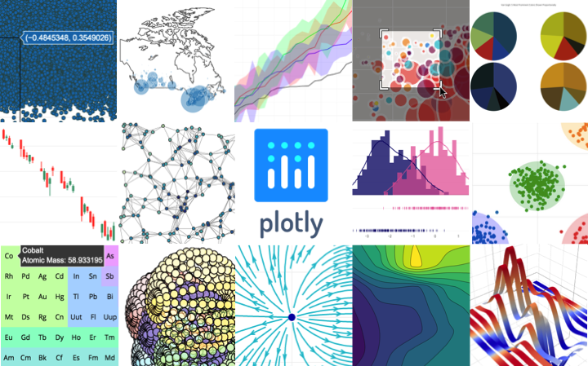
Plotly
Plotly is an open-source interactive graphing library. It makes use of Dataframes to display information through visual representations.
Note:
Source:

Slide 12
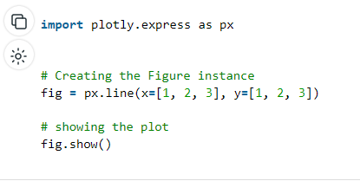
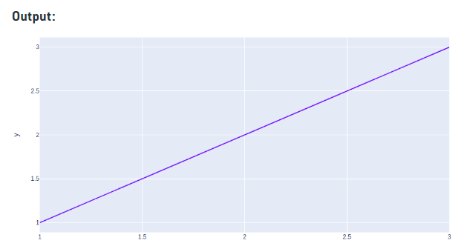
Plotly Figures
Note:
Source:

Slide 13
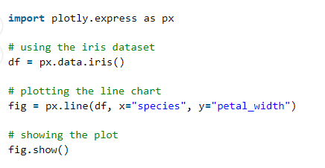
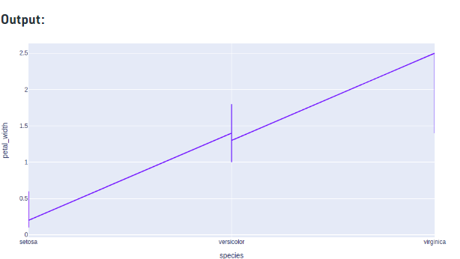
Plotly Figures and Dataframes
Note:
Source:

Slide 14
Dash

Slide 15
Dash Overview
Dash is an open source framework that allows developers to build web data visualization apps. It takes advantage of Pandas and Plotly to display figures using a layer of HTML within Python.
Having some HTML knowledge comes handy when learning Dash, although this skill can also be acquired along the way.
Note:
Source:

Slide 16
Bootstrap
Bootstrap is a free and open-source CSS framework that contains templates for multiple JavaScript and HTML components.
Overall, it helps us give life to our web applications in an easier way.
Luckily, Bootstrap is available within Dash.
Note:
Source:

Slide 17
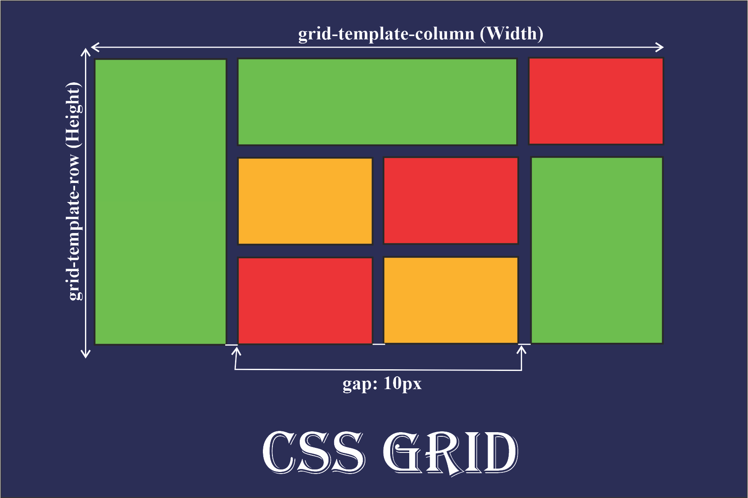
Grid Layout
CSS offers a grid layout with Rows and Columns, which makes arranging elements inside our app more intuitive.
Note:
Source:

Slide 18
Divs, Rows, and Columns
Div: Simply a container that defines a section within the web app. Any type of content can be put inside a Div, and Divs may be put inside Divs to better arrange or style that particular section.
Rows, columns, and divs are used collectively to style our layout grid.
Note:
Source:

Slide 19
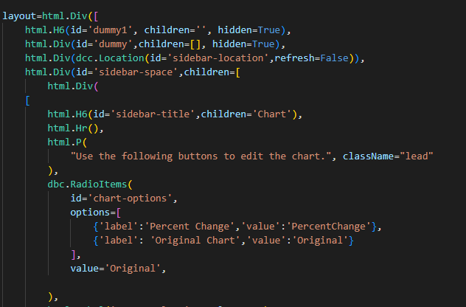
Dash Syntax
All dash components must be placed inside a layout variable.
Note:
Source:

Slide 20
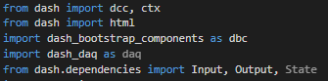
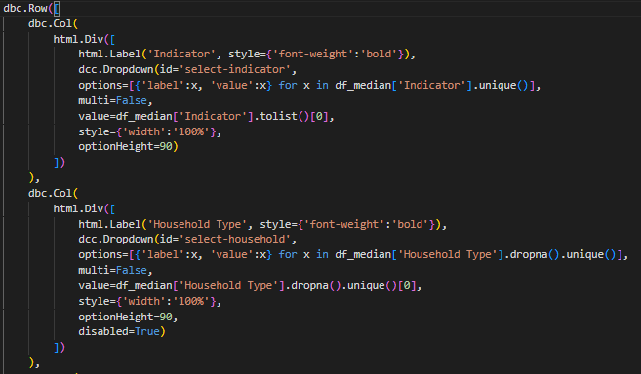
Dash Syntax
These are objects, so their attributes are declared inside the ().
The ID attribute is highly important as it will allow us to access our elements dynamically.
Note:
Source:

Slide 21
Dash Syntax
Dash documentation:
https://dash.plotly.com/
Note:
Source:

Slide 22
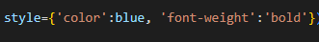
Dash Syntax
For every element, we can use the “style” component, which will help us give the element a desired format.
Note:
Source:

Slide 23
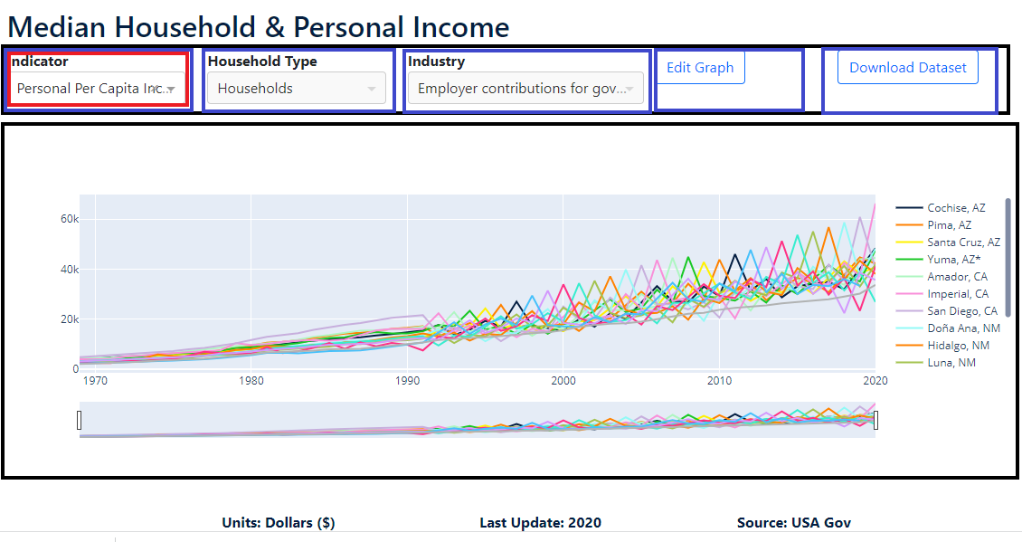
Header
Note:
Source:

Slide 24
Dash Callbacks

Slide 25
Callbacks
Callbacks are a Dash property that allows us to make our web apps interactive. Through callbacks, we can use the characteristics of one or multiple elements (Inputs) to modify other elements (Outputs).
This way, we can use Dash elements to select certain data from our data frames and filter the information being shown in our figures.
Note:
Source:

Slide 26
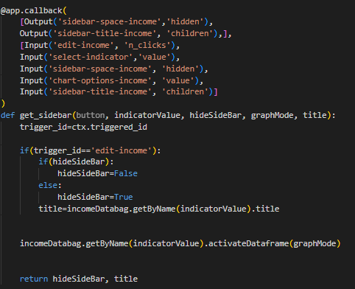
Callbacks Syntax
Callbacks are placed after the layout of our app or page using “@app.callback”. They must be followed by a function.
Inside the callback, we must first list our Outputs, and then our Inputs.
Note:
Source:

Slide 27
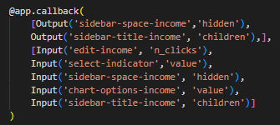
Callback Syntax
When defining an Output or Input, we must declare it in the following way:
Input(object id, object property)
Output(object id, object property)
Note:
Source:

Slide 28
Callback Syntax
Every Input inside our Callback must be a parameter inside the callback function.
Every Output inside our Callback must be a return value that comes as a result of the callback function.
Note:
Source:

Slide 29
Callbacks
Important Points:
We can define multiple callbacks within our web app or page.
Inputs can be shared between callbacks.
Outputs cannot be shared between callbacks.
Objects must have a unique id.
All Inputs of our Callback will trigger the Callback, even if the other elements have not changed.
All callbacks will be performed when our app is initially ran unless we prevent this.
Note:
Source:

Slide 30
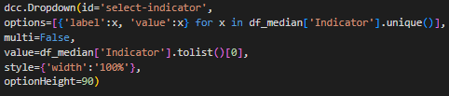
Dropdowns
We must indicate what the options for our dropdown will be. We can use the information from the dataframe so that it’ll be easier to later filter the information.
Note:
Source:

Slide 31
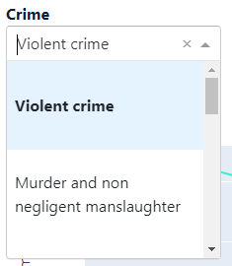
Dropdowns
That way, the contents of your dropdown will be the exact same as the contents of our dataframe, and once we select an option on the Dropdown we can simply filter the data.
We can think of this as using the Filter option in Excel.
Note:
Source:

Slide 32
Documentation
When in doubt, visit the documentation.
https://dash.plotly.com/
https://plotly.com/python/
https://pandas.pydata.org/docs/
Note:
Source:

Slide 36
Locate us:
The University of Texas at El Paso Hunt Institute for Global Competitiveness University of Texas at El Paso (UTEP) Kelly Hall Building, Suite 414 El Paso, Texas 79968-0545
Monthly Newsletter
Sign up today!
View our Newsletter
Connect with us:
E: huntinstitute@utep.edu P: (915) 747-6727 F: (915) 747-7948

